Slide 1


Architecture of Complex Systems
Week 2: Function and Emergence
Project Portfolio
Name
John Doe

Slide 2
STEP 1: ABSTRACTION OF FORM
For the system you chose in Week 1, list five or more object elements or abstractions of form, to make a level 1 decompositional view. Don’t feel constrained to use the same objects as you listed in Week 1.
Object elements or abstractions of form:
1 Bit Adder
Exclusive disjunction (XOR) - gate
Logical conjunction (AND) - gate
Logical disjunction (OR) – gate
External SUM bit
Carry out bit
Please describe how and or why you used these elements / abstractions of form to construct your graphical decompositional view for the form of your system.
Personal description.

Slide 3
STEP 2: SYSTEM OPERANDS AND FUNCTIONS
For your next step, you will consider value related and principal internal operands and states. With your chosen system in mind, answer the following questions:
What is the value related operand? What is/are the value related states that change? Value related process of changing those states?
Data bits;
Bit value zero (0) and one (1);
Adding.
What are the principal internal operands? What principal internal processes act on them? what are the principal internal functions?
Internal data bits (attributes are value 0 and value 1)
Exclusive disjunction (XOR), logical conjunction (AND) and logical disjunction (OR) which present the process of each logical gate
Data bits are “ANDed”; Data bits are “ORed”; Data bits are “XORed”
How do the principal internal functions connect to form the primary value pathway? How does the external function emerge from these internal functions?
How do internal functions map to objects of form? How do the operands move between or change because of objects of form?
The external function emerges from the sub-interrelated internal functions such as internal data bits are “ANDed”, “ORed” and “XORed”. The external “adding” process emerges from such internal processes. The internal operand, “internal data bit” is influenced by the structure of the form.
Exclusive disjunction (XOR) – XOR Gate
Logical conjunction (AND) – AND Gate
Logical disjunction (OR) – OR Gate
The operands (data bits) are changed by structural relationships between the objects of form (logic gates)

Slide 4
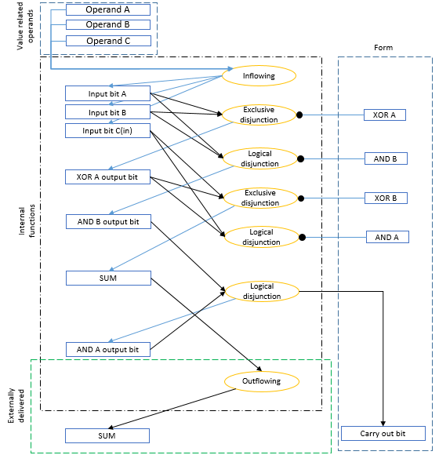
STEP 3: DEVELOP AN OPM DIAGRAM
For your system, develop an OPM diagram and insert the diagram below. Highlight or circle and label the the following: value related operand, delivered function, internal functions (operands and processes), and form. Provide a brief description of each in the field provided in the next slide.
Please remember the file size limit and resize* or paste the image URL instead, as needed.
System Diagram/Schematic
Notes:
* To resize a PowerPoint presentation: http://powerpoint.wiziq.com/topic/504-6-tips-to-reduce-the-size-of-your-powerpoint-file

Slide 5
STEP 3: DEVELOP AN OPM DIAGRAM
Provide a brief description of each in the field provided of the following: value related operand, delivered function, internal functions (operands and processes), and form.
Value Related Operand:
Delivered Function:
Internal Functions
(operands and processes):
Form:
Data bits, input data bits are processed by the internal functions and output data bits are produced.
Adding data bits and output data bits are produced.
Value pathway internal functions and processes described:
Input data bits are exclusive disjunction (“XORed”) by an XOR logic gate.
Internal data bits are exclusive disjunction (“XORed”) by an XOR logic gate.
Outflowing data bit (SUM) is produced
“XOR” Gate, “AND” Gate and “OR” Gate

Slide 6
STEP 4: FUNCTIONAL INFORMATION
For your last step, you will think about how functional information is normally conveyed in your field or discipline. Cite and briefly describe a specific example.
Give a brief description of your field and how functional information is normally conveyed. Are processes indicated? Operands? Are processes and operands combined into functions? In your description, be sure to cite at least one example:
Personal write-up based on the students experience.

Slide 7
STEP 1: ABSTRACTIONS OF FORM
For the system you chose in Week 1, list five or more object elements or abstractions of form, to make a level 1 decompositional view. Don’t feel constrained to use the same objects as you listed in Week 1.
Object elements or abstractions of form:
Balsa Glider
Fuselage
Wing
Stabilizer
Fin
Counter weight
Propeller
Please describe how and or why you used these elements / abstractions of form to construct your graphical decompositional view for the form of your system.
Personal description.

Slide 8
STEP 2: SYSTEM OPERANDS AND FUNCTIONS
For your next step, you will consider value related and principal internal operands and states. With your chosen system in mind, answer the following questions:
What is the value related operand? What is/are the value related states that change? Value related process of changing those states?
Person;
Bored – entertained;
Entertaining.
What are the principal internal operands? What principal internal processes act on them? what are the principal internal functions?
Person/user, with attributes bored and entertained
Assembling, launching, lifting, spinning and observing.
Kit - assembling; glider - launching; glider – lifting; propeller – spinning; person – observing.
How do the principal internal functions connect to form the primary value pathway? How does the external function emerge from these internal functions?
How do internal functions map to objects of form? How do the operands move between or change because of objects of form?
The components income to the product system boundary. The user is an instrument to assembling the glider. The user then becomes an instrument to launching the glider. Once the glider is flying, the value related operand is observing and becomes entertained.
External function emerges through the observation of the glider in flight by the value related operand, the person or user.
Kit – Assembling
Glider – launching
Glider – lifting
Glider – guiding
User – observing

Slide 9
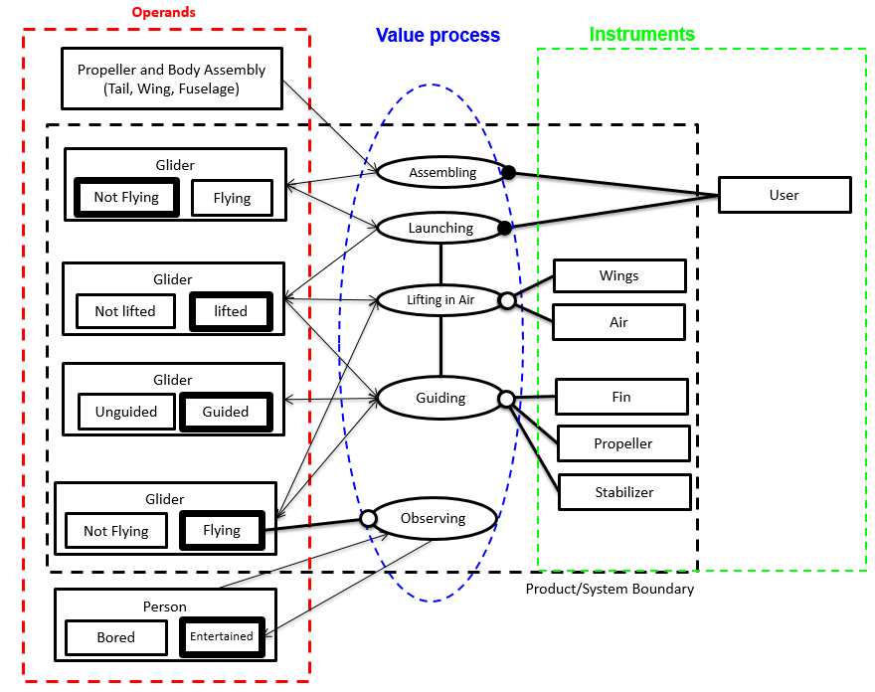
STEP 3: DEVELOP AN OPM DIAGRAM
For your system, develop an OPM diagram and insert the diagram below. Highlight or circle and label the the following: value related operand, delivered function, internal functions (operands and processes), and form. Provide a brief description of each in the field provided in the next slide.
Please remember the file size limit and resize* or paste the image URL instead, as needed.
System Diagram/Schematic
Notes:
* To resize a PowerPoint presentation: http://powerpoint.wiziq.com/topic/504-6-tips-to-reduce-the-size-of-your-powerpoint-file

Slide 10
STEP 3: DEVELOP AN OPM DIAGRAM
Provide a brief description of each in the field provided of the following: value related operand, delivered function, internal functions (operands and processes), and form.
Value Related Operand:
Delivered Function:
Internal Functions
(operands and processes):
Form:
Person, the user is an instrument to the system. However, he’s also the value related operand as he becomes entertained by observing.
Person entertaining, is the externally primary value related function.
Propeller and body assembling, is the function being performed by the user.
Launching glider is being performed by the user as an instrument to the operation.
Glider lifting, the air is and wings allow the glider to lift.
Glider guided, the propeller, stabilizer and fin allow the glider to have a guided flight.
The user is observing the flying glider and becomes entertained.
Wing, fuselage, fin, stabilizer, counter weight, propeller.

Slide 11
STEP 4: FUNCTIONAL INFORMATION
For your last step, you will think about how functional information is normally conveyed in your field or discipline. Cite and briefly describe a specific example.
Give a brief description of your field and how functional information is normally conveyed. Are processes indicated? Operands? Are processes and operands combined into functions? In your description, be sure to cite at least one example:
Personal write up based on the students experience.

Slide 12
STEP 1: ABSTRACTIONS OF FORM
For the system you chose in Week 1, list five or more object elements or abstractions of form, to make a level 1 decompositional view. Don’t feel constrained to use the same objects as you listed in Week 1.
Object elements or abstractions of form:
Crystal Radio
Crystal earphone
Diode
Variable capacitor
LC circuit
Antenna
Wire
PBC
Please describe how and or why you used these elements / abstractions of form to construct your graphical decompositional view for the form of your system.
Personal description.

Slide 13
STEP 2: SYSTEM OPERANDS AND FUNCTIONS
For your next step, you will consider value related and principal internal operands and states. With your chosen system in mind, answer the following questions:
What is the value related operand? What is/are the value related states that change? Value related process of changing those states?
Radio signal;
electrical signal – audio signal;
converting.
What are the principal internal operands? What principal internal processes act on them? what are the principal internal functions?
Electrical signal with attributes: current, noise, frequency.
Inducing, selecting, rectifying, filtering, translating
Electrical signal inducing; Frequency selecting; Current rectifying; Noise filtering; Electrical signal translating
How do the principal internal functions connect to form the primary value pathway? How does the external function emerge from these internal functions?
How do internal functions map to objects of form? How do the operands move between or change because of objects of form?
The antenna induces the electrical signal. LC circuit is selecting the frequency. The diode is rectifying the current. The capacitor is filtering the noise. The crystal earpiece is translating the electrical signal.
External function emerges through the conversion of the radio signal through different functions into an audio signal.
Inducing – Antenna;
Selecting – LC Circuit
Rectifying – Diode
Filtering – Capacitor
Translating – Crystal earpiece

Slide 14
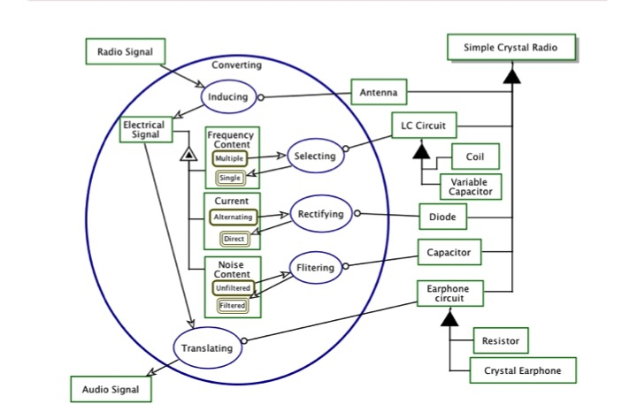
STEP 3: DEVELOP AN OPM DIAGRAM
For your system, develop an OPM diagram and insert the diagram below. Highlight or circle and label the the following: value related operand, delivered function, internal functions (operands and processes), and form. Provide a brief description of each in the field provided in the next slide.
Please remember the file size limit and resize* or paste the image URL instead, as needed.
System Diagram/Schematic
Notes:
* To resize a PowerPoint presentation: http://powerpoint.wiziq.com/topic/504-6-tips-to-reduce-the-size-of-your-powerpoint-file

Slide 15
STEP 3: DEVELOP AN OPM DIAGRAM
Provide a brief description of each in the field provided of the following: value related operand, delivered function, internal functions (operands and processes), and form.
Value Related Operand:
Delivered Function:
Internal Functions
(operands and processes):
Form:
Signal, the radio signal (operand) is what is being transformed by the internal functions.
Signal converting, is the externally primary value related function.
Electric signal inducing, is the function being performed by the antenna.
Frequency selecting, the LC circuit is selecting the appropriate frequency.
Current rectifying, the diode then rectifies it.
Noise filtering, the capacitor smooths the signal or removes the noise.
Electrical signal translating, the output is then translated to audio by the crystal earpiece.
Antenna, LC Circuit, Diode, Capacitor, crystal earpiece.

Slide 16
STEP 4: FUNCTIONAL INFORMATION
For your last step, you will think about how functional information is normally conveyed in your field or discipline. Cite and briefly describe a specific example.
Give a brief description of your field and how functional information is normally conveyed. Are processes indicated? Operands? Are processes and operands combined into functions? In your description, be sure to cite at least one example:
Personal write up based on the students experience.

Slide 17
STEP 1: ABSTRACTIONS OF FORM
For the system you chose in Week 1, list five or more object elements or abstractions of form, to make a level 1 decompositional view. Don’t feel constrained to use the same objects as you listed in Week 1.
Object elements or abstractions of form:
Prime Number
Temporary memory
Memory registers
Code
Please describe how and or why you used these elements / abstractions of form to construct your graphical decompositional view for the form of your system.
Personal description.

Slide 18
STEP 2: SYSTEM OPERANDS AND FUNCTIONS
For your next step, you will consider value related and principal internal operands and states. With your chosen system in mind, answer the following questions:
What is the value related operand? What is/are the value related states that change? Value related process of changing those states?
Number(s);
Unknown prime numbers – only prime numbers;
searching.
What are the principal internal operands? What principal internal processes act on them? what are the principal internal functions?
Internal number (n) with attributes prime and not prime.
Importing, calculating, looping, testing, appending, printing.
Importing external number; calculating number range; testing number; appending number; printing prime array
How do the principal internal functions connect to form the primary value pathway? How does the external function emerge from these internal functions?
How do internal functions map to objects of form? How do the operands move between or change because of objects of form?
External function emerges through search for prime numbers through different functions into a prime-only array that is printed to console.
Importing var to temp memory
Calculating range to search to temp memory
Looping range (n) in memory with for loop code
Testing var (i) if prime with prime test code function
Appending prime numbers to prime array
Printing prime array

Slide 19
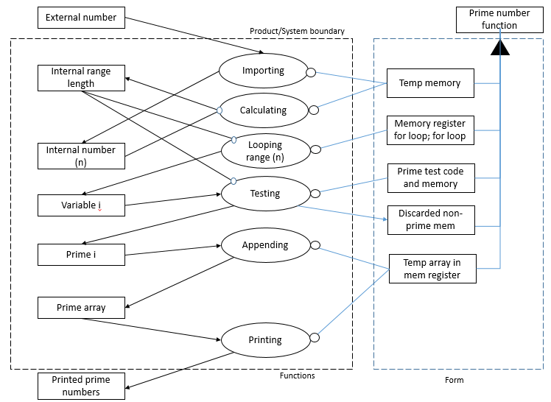
STEP 3: DEVELOP AN OPM DIAGRAM
For your system, develop an OPM diagram and insert the diagram below. Highlight or circle and label the the following: value related operand, delivered function, internal functions (operands and processes), and form. Provide a brief description of each in the field provided in the next slide.
Please remember the file size limit and resize* or paste the image URL instead, as needed.
System Diagram/Schematic
Notes:
* To resize a PowerPoint presentation: http://powerpoint.wiziq.com/topic/504-6-tips-to-reduce-the-size-of-your-powerpoint-file

Slide 20
STEP 3: DEVELOP AN OPM DIAGRAM
Provide a brief description of each in the field provided of the following: value related operand, delivered function, internal functions (operands and processes), and form.
Value Related Operand:
Delivered Function:
Internal Functions
(operands and processes):
Form:
Number (range), the number (operand) is what is being transformed by the internal functions.
Prime array printing, is the externally primary value related function.
External number importing
Calculating internal range length
Looping range length
Testing variable (i)
Appending prime (i)
Printing prime array
Temporary memory, Memory registers, Code

Slide 21
STEP 4: FUNCTIONAL INFORMATION
For your last step, you will think about how functional information is normally conveyed in your field or discipline. Cite and briefly describe a specific example.
Give a brief description of your field and how functional information is normally conveyed. Are processes indicated? Operands? Are processes and operands combined into functions? In your description, be sure to cite at least one example:
Personal write up based on the students experience.

Slide 22
STEP 1: ABSTRACTIONS OF FORM
For the system you chose in Week 1, list five or more object elements or abstractions of form, to make a level 1 decompositional view. Don’t feel constrained to use the same objects as you listed in Week 1.
Object elements or abstractions of form:
Telescope
Objective lens
Eyepiece lens
Eyepiece
Focal tube
Focus knob
Legs
Focal tube mount
Tripod flange
Please describe how and or why you used these elements / abstractions of form to construct your graphical decompositional view for the form of your system.
Personal description.

Slide 23
STEP 2: SYSTEM OPERANDS AND FUNCTIONS
For your next step, you will consider value related and principal internal operands and states. With your chosen system in mind, answer the following questions:
What is the value related operand? What is/are the value related states that change? Value related process of changing those states?
Light;
Diluted light – concentrated light;
Concentrating
What are the principal internal operands? What principal internal processes act on them? what are the principal internal functions?
light and converged light;
converging and focusing;
(1) “converging light” and (2) “focusing converged light”.
How do the principal internal functions connect to form the primary value pathway? How does the external function emerge from these internal functions?
How do internal functions map to objects of form? How do the operands move between or change because of objects of form?
As the light enters the system and then passes through the first lens where it is converged and then as it passes through the second lens it is focused, so that the end result of the system is that light is concentrated.
External function is concentrating light. The primary purpose or, what the system was built for.
Converging light maps to the objective lens.
Focusing light maps to the eyepiece lens
Supporting lenses maps to the focal tube

Slide 24
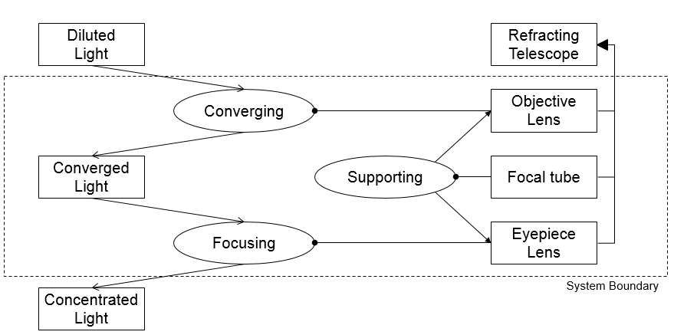
STEP 3: DEVELOP AN OPM DIAGRAM
For your system, develop an OPM diagram and insert the diagram below. Highlight or circle and label the the following: value related operand, delivered function, internal functions (operands and processes), and form. Provide a brief description of each in the field provided in the next slide.
Please remember the file size limit and resize* or paste the image URL instead, as needed.
System Diagram/Schematic
Notes:
* To resize a PowerPoint presentation: http://powerpoint.wiziq.com/topic/504-6-tips-to-reduce-the-size-of-your-powerpoint-file

Slide 25
STEP 3: DEVELOP AN OPM DIAGRAM
Provide a brief description of each in the field provided of the following: value related operand, delivered function, internal functions (operands and processes), and form.
Value Related Operand:
Delivered Function:
Internal Functions
(operands and processes):
Form:
“Light” is the operand as it is modified by the telescope
The externally delivered primary value related function is “concentrating light”, as the Function = Process + Operand and as that is the main value of a telescope.
Objective lens is converging the light towards a concentrated single point.
Eyepiece lens focuses the converged light.
The tube is supporting the objective lens and eyepiece lens at a set distance and position. Provides structural relationships.
Objective lens, eyepiece lens and tube.

Slide 26
STEP 4: FUNCTIONAL INFORMATION
For your last step, you will think about how functional information is normally conveyed in your field or discipline. Cite and briefly describe a specific example.
Give a brief description of your field and how functional information is normally conveyed. Are processes indicated? Operands? Are processes and operands combined into functions? In your description, be sure to cite at least one example:
Personal write up based on the students experience.

